Slide 1
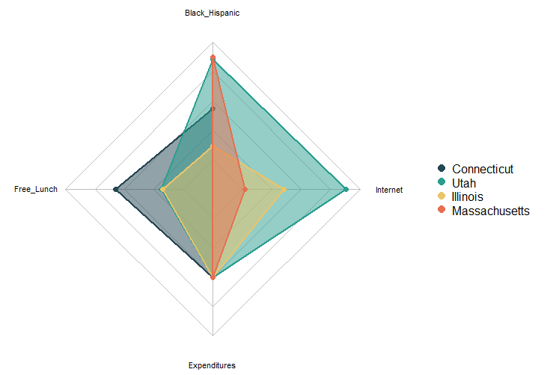
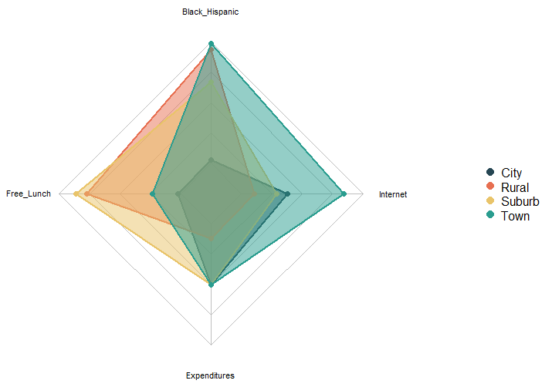
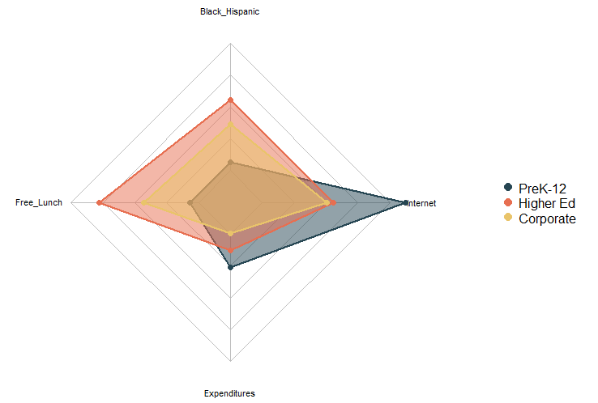
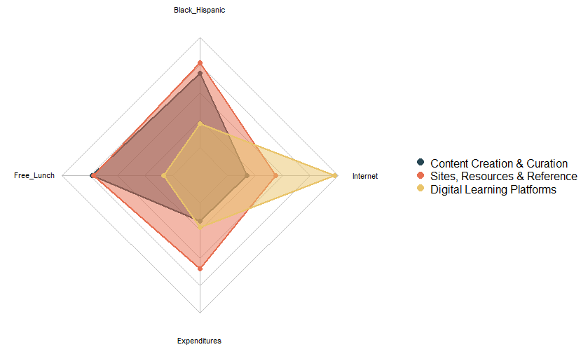
Digital Learning Demographic Profiles
In the year 2020, the COVID-19 Pandemic swept the globe causing global shutdowns of businesses and schools.
In an attempt to adapt, schools implemented digital learning. The following is data courtesy of LearnPlatform to investigate the demographics of students during this time period.
by State
by Locale
State where
District Resides
BACKGROUND
Area
Classification
There are 4 radar charts that compare relative difference across student profiles by State, Locale, Sector, and Function. Each profile examines % Black/Hispanic, % free/reduced lunch, per-pupil expenditures, and access to internet connection.
GRAPHS
by Sector
by Function
The following profiles seem to be fairly similar in comparison with their relative counterparts: Illinois (State), City (Locale), PreK-12 (Sector), Digital Learning (Function).
Each of these Demographic Profiles has relatively low rates of racial diversity and reduced-lunch eligible students. These Profiles also have relatively high or average access to reliable internet sources.
Sector of Education
where Product is Used
Basic Function
of the Product
TAKEAWAYS
MSDS 455 | Fall 2023 | Kay Quiballo
Source: https://www.kaggle.com/competitions/learnplatform-covid19-impact-on-digital-learning/data

